Slide 1
Gender challenges and priorities in 3 Norwegian municipalities
16. September 2015
Liss Schanke
Norwegian Association of Local and Regional Authorities

Slide 2
Presentation plan
Select 3 legal acts/areas that are relevant to gender equality
Show how these areas are monitored/measured at the municipal level
Select 3 different municipalities as examples
Show their indicators, challenges and initiatives in the 3 areas
Describe what KS is doing at the national level

Slide 3
Gender Equality Acts: 3 examples
Ensure general gender equality: The Gender Equality Act 1978
Ensure kindergartens for all children at affordable price: The Kindergarten Act 1975
Ensure decent life and prevent poverty for all citizens: The Social Security Act 1991

Slide 4
Gender Equality Act 1978
Prohibits gender discrimination and promotes gender equality in all sectors of society.
Additions to the Act from 1981 and onwards states that both sexes should be represented in all public boards and committees – not less than 40% of each sex.

Slide 5
The Kindergarten Act, 1975
States that municipalities must ensure a sufficient number of kindergarten places to meet the actual demand. All children 1-5 years of age have a legal right to a full time kindergarten place in the municipality where they live, in a municipal or private kindergarten.
The regulations to the act set a maximum parental fee for a kindergarten place regardless of ownership, determined by Parliament in the state budget each year.

Slide 6
Social Security Act 1991
Constitutes a social security net for persons and families unable to provide for themselves – services as well as allowances.
Norway – as the other Nordic countries – are well developed welfare states with extensive social security systems and high benefits, including child grants, grants for single parents, maternal and paternal leave, unemployment benefits and pensions. The social security act covers vulnerable persons and families e.g. refugees and unemployed

Slide 7
Monotoring and measuring at municipal level
Municipal gender equality index
Mainstreamed: collected and analysed annually by Statistical Bureau
Covers 16 key indicators relevant to gender equality
Covers all 428 municipalties and 18 provinces
Enables them to compare their results with the national average and with their neighbours – as well as their own development over time.
Basis for administrative planning of gender equality initaives
Basis for political decisions across party lines

Slide 8
Gender equality
Indicators
Percentage men 20-66 working part time
Percentage women 20-66 working part time
Percentage fathers taking full fathers quota or more
Percentage women municipal council members
Percentage women employees 20-66 in the public sector
Percentage women employees 20-66 in the private sctor
Percentage women among leaders 20-66
Level of gender balanced business structure
Level of gender balance in educational programs in upper secondary school

Slide 9
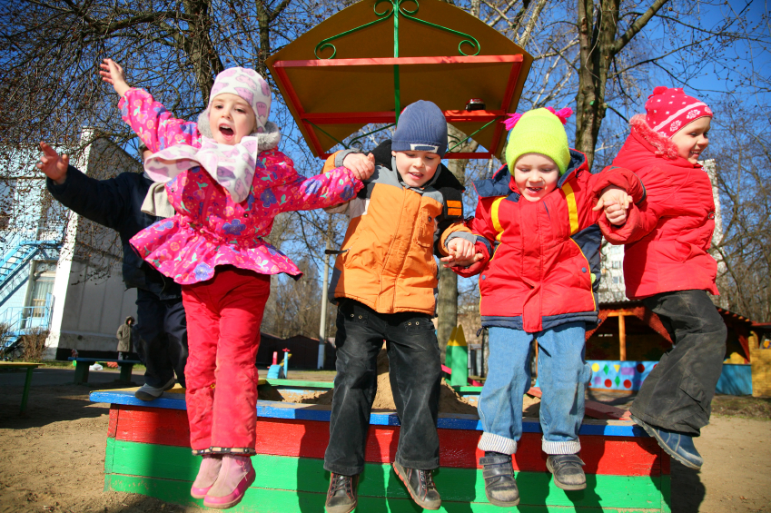
Kindergartens
Indicators
Percentage 1-5 years in kindergartens
(Kindergartens are believed to be important to childrens’s development and future learning, especially children from poor or immigrant families – apart from being important for working parents)

Slide 10
Social security
Indicators
Percentage men with higher education
Percentage women with higher education
Percentage men 20-66 in the work force
Percentage women 20-66 in the work force
Average gross income for men
Average gross income for women

Slide 11
Three municipalities
Kristiansand: 87.000
Focus on broad gender equality strategies, necessary approach in a conservative region
Gran: 14.000
Focus on kindergartens and good services to keep and atract young people in a rural area
Sagene/Oslo: 40.000/600.000
Focus on social inclusion and employment in a multicultural district of the capital Oslo

Slide 12
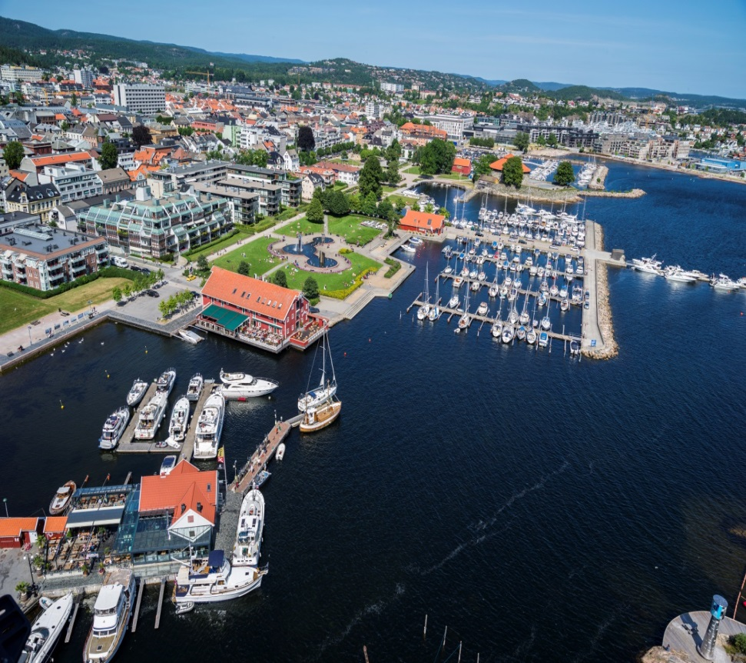
Kristiansand municipality
Biggest city in Southern Norway
Administrative, business and university centre
87 000 inhabitants
Large number of companies related to the oil industry
Recently affected by decline in oil sector prices and jobs

Slide 13
Kristiansand: Key challenges
Overall challenges: traditional region
Agder region in the south of Norway: conservative region
Kristiansand: Least equal of 5 biggest N. cities, but the most equal in the Agder region
Specific challenges
38% of women work part-time. Some voluntarily, some not
Many women do not have paid work at all.
Women/men have lower educational level than other cities.
Education/labour life more gender divided than other cities.
Men: mainly management and technical professions - in private sector, women:care and education - in public sector.

Slide 14
Kristiansand: Initiatives
Elaboration of a municipal and strategy for equality, inclusion and diversity 2015-2022
Participating in the regional strategy for equality, inclusion and diversity 2015-2027
Gender mainstreaming - equality is every leader’s responsibility
Developing a full time culture – for several reasons
  Wanted part time for some means unwanted part time for others
  Difficult to recruit young women and men to part time jobs
  Full time improves continuity for users/quality of service
  Full time staff more involved in the job and in capacity building
  More elderly people means we need all the work force

Slide 15
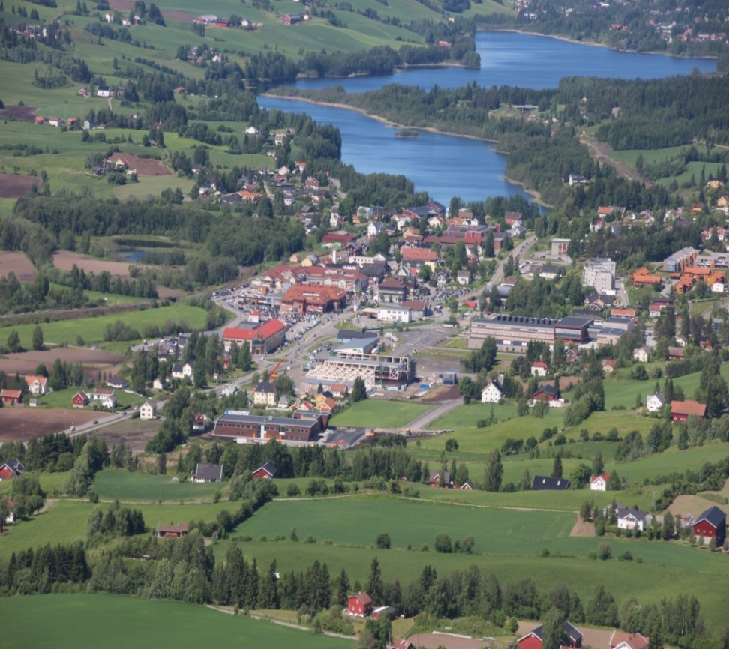
Gran muncipality
Rural municipality, 60 km. north of Oslo
14.000 inhabitants
Long traditions in agriculture and forestry
6% of the population engaged in farming, 16% in industry/construction, 78% in commerce and services
2000 persons, work outside Gran, half of them in Oslo, the rest in neighbour communities.

Slide 16
Gran: Key challenges
General challenge – typical for small rural municipalities
Elderly population – as many small rural municipalities.
Not sustainable with regard to demography/economy
Lower educational than in Oslo and Kristiansand
Specific challenges
Gran needs to keep and attract young people as a basis for a sustainable LG economy/labour market – with higher education.
Young people want children, kindergartens, schools, other public services, facilities for culture/sports + flexible working hours
Advantage 1: price of house/garden= tiny apartment in Oslo
Advantage 2: 60 km. from Oslo, easy to commute+work from home

Slide 17
Gran: Initiatives
Gran ensures kindergarten 1-6 years for all children
Gran has 16 kindergartens, 9 private and 7 public
Private kindergartens have public support and are supervised by the municipality.
Services after school is still a challenge.
All schools have activities before and after school for pupils 6-10 years, 07.00-16.30
Parents pay for the number of hours they need – expensive. 27 hours a week costs 377 Euro a month.
Few parents want full time, many buy extra hours when they need it.

Slide 18
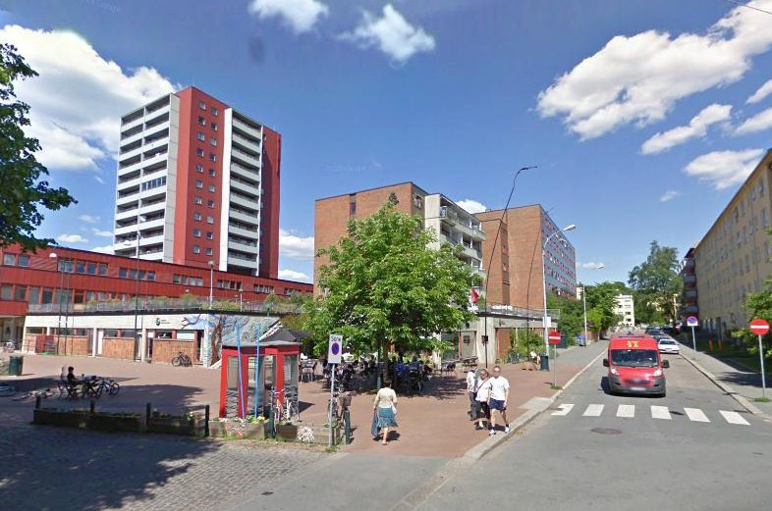
Sagene district in Oslo
Oslo, the capital of Norway, 600.000 inhabitants
One of the 15 districts in Oslo, 40.000 inhabitants
Separate administration and political council.
Mixed population: middle class + people living in the 2.400 public apartments, i.e. persons who cannot afford to buy/rent open market apartments: e.g. immigrants, refugees, people with health/drug problems.

Slide 19
Sagene: Key challenges
25% immigrants, mainly non-western countries. Largest group is Somalia, then Morocco, Algeria, Iran, Iraq, Pakistan.
The big Somalian group, came as political or humanitarian refugees after year 2000, most with a very low educational level, many illiterate – and depend on public houses and services
High persistent relative poverty rate for families with children, i.e. poverty lasting more than 3 years, but low absolute poverty according to international rates.
Relative and absolute poverty in Norway is closely linked to unemployment, around 3-4% for adults, 7% for young people.
Unemployment rate higher for first and second generation of immigrants
Employment rate is lower, especially for immigrant women.
Large percentage of young immigrants drop out of school – especially boys

Slide 20
Sagene: Initiatives
Keeping the middle class happy and make them want to live in the district:
  high quality services, cultural/interesting community, volunteer activities
Inclusion/participation against marginalization/family poverty
  activation, education, employment for young people
  activation, capacity building, language, employment for adult men and women
  including children in kindergartens and extra curricular school activities
  community development in the public housing areas.

Slide 21
Role of Local Government Association, KS
Organisation for all 428 municipalities/18 provinces
250 employees, offices in all provinces
Employers organisation: bilateral and tripartite dialogue and negotations on key gender equality issues, e.g. part time and pay gap
Networking: efficiency networks e.g. kindergartens
Interest organisation: Regular consultations with key ministries several times a year on financial and legislative issues, e.g. kindergartens/social security

Slide 22
Consultative meetings with government
Permanent Joint Committee for Assessment of Local Government Economy (important precondition for implementation of legislation)
4 annual political meetings + adm. preparations
  Feb: Economic situation for the coming year
  - April: State initiated reforms and changes
  - Aug: Bilateral meetings with key ministries
  Oct: Joint document - effects of budget
Advantage: early LG involvement, more LG influence
Notes:
First meeting:

Slide 23
Some experiences
Important to develop simple monitoring and measuring systems for gender equality
Systems should be mainstreamed – i.e. integrated into permanent institutions, staff and budgets - not depending on ad hoc externally funded projects
Statistics is an possible method, and can be a powerful tool for NGOs, for media, for politicians, for media and for legislators

