Slide 1
The Norwegian paradox
Today everything is set for gender equality regarding work-life balance in Norway
Still we have great differences between men and women regarding time use, equal pay and sector segregation in the labour marked.

Slide 2
A political will to facilitate the work-life balance
High labor force participation among women
Family politics in working life (part time, breaks for breastfeeding, parental leave, leave due to sick children)
High proportion of women in higher education
Available day care
From bread winning fathers to participating fathers
Strengthening of The Gender Equality Act
High proportion of women in higher education

Slide 3
In spite of all this - the Ombud's office receives many complaints about for examples pregnancy related discrimination in working life

Slide 4
Some historic explanations of the paradox
Notes:
Internationally forerunner, but still a long way to go
Why rise awareness about pregnancy related discrimination?
This is the area where the gender differences are most apparent
The most central issue to gender equality
The career gap between women and men, when it comes the gender pay gap and the level of position, peaks as a result of pregnancy and maternity leave. The women start falling behind and the men’s careers are starting to take off.
Other grounds might benefit from the attention by raising greater awareness of unfairness of discrimination

Slide 5
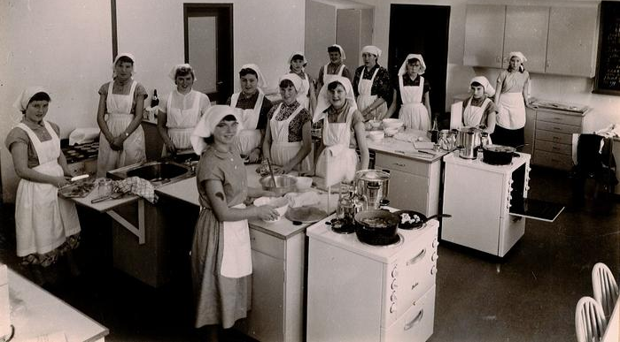
Norwegian classroom, 1969

Slide 6
Housewive society

Slide 7
The breadwinning father

Slide 8
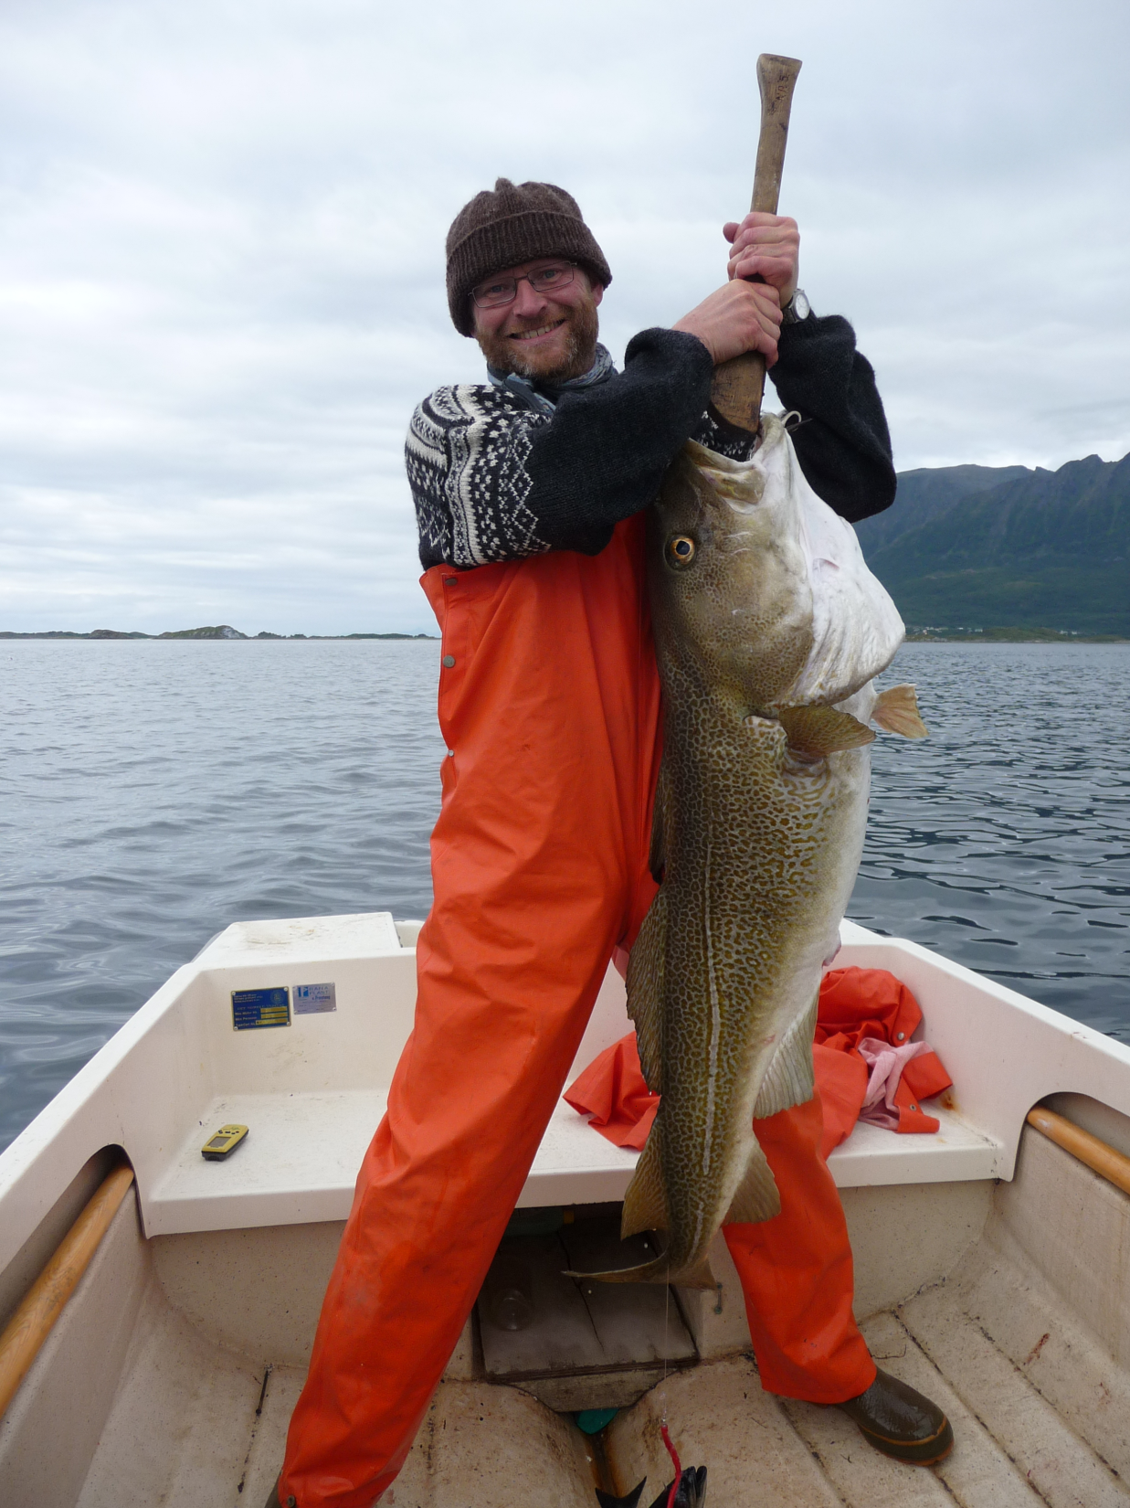

Slide 9
Modernity
expansion of the welfare state
need of labor force
women entered the labor market
education revolution
social and geographic mobility

Slide 11
Housewives become part time workers

Slide 12
Yrkesaktivitet og arbeidstid blant kvinner og menn 25-54 år

Slide 13
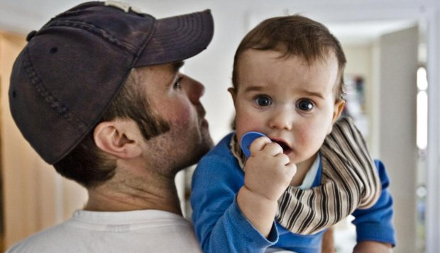
The helping father

Slide 14
Fathers share of parental leave days

Slide 15
Time spent on paid work and house work/care

Slide 16
What is the paradox
Gender equality politics makes it possible for women to combine work and family,
BUT it also cement the gender stereotypes because fathers use them less or do not use them at all

Slide 17
How can we explain the paradox?
Working mothers make most use of the welfare benefits
This makes working mothers less attractive in the labor market
This is an important mechanism for discrimination

Slide 18
What can we do whit the paradox?
What is the prevalence of pregnancy related discrimination in the Norway
Without having the possibility to combine paid work and caring for children, there can be no equality between men and women
We need that men use family friendly arrangement in the same that women do
We need employers to respect the act and se the benefits in having a non discriminatory policy

Slide 19
A campaign against pregnancy related discrimination

Slide 20
Campaign strategy

Slide 21
Target groups
Jobseekers and employees
Expectant parents
Parents on leave
Young people
Employers

Slide 22
The social partners
In Norway the social partners hold an influential position
There can be no change in the working life without contribution from the social partners
Cooperation with the social partners

Slide 23
Campaign elements
Survey
Digital Campaign about rights
Guide for employers
Equality
training

Slide 24
Digital campaign about rights
Campaign webpage
Facebook page
Ads
Quiz
Cartoons
Infographics

Slide 25
Digital Campaign Elements
Infographics
Cartoon

Slide 26
Digital Campaign Elements
Advertisement
Facebook

Slide 27
Results from the digital campaign
New likes | Visits to LDO.no | Ads shown to
656 | 46 529 | 636 691

Slide 28
Guide for employers

Slide 29
Guide for employers
Best practices
Interview with employers who don’t see pregnancy and parental leave as a problem

Slide 30
Guide for employers
Don’t make these mistakes
The Gender Equality Act

Slide 31
Guide for employers
Test your business
Check list: How does your business score?

Slide 32
Checklist

Slide 33
Survey on discrimination on the basis of pregnancy and parental leave

Slide 34
Survey facts
2000 respondents
56 % women
44 % men
Women and men who had become child/children during the period 2008-2014

Slide 35
The questions
Questions on the basis of the provisions in the Norwegian equality Act:
Experiences in relation to applying for jobs, at work when expecting a child, during and after parental leave.
Negative experiences, not necessarily illegal

Slide 36
Examples from the questionnaire
Have you ever been asked if you were planning to have a child or if you were expecting a child/pregnant in connection with interviews/processes of seeking employment?
Have you been denied an extension of a substitution position or other temporary position because you were on leave in connection with childbirth?
Have you been demoted, for example deprived of responsibility or title, after returning from leave in connection with childbirth (in the period 2008-2014)?

Slide 37
Main findings
The survey shows that workers experience discrimination:
Throughout the working life
In both public and private sector
In every branch
In all parts of the employment relationship

Slide 39
Other negative experiences

Slide 40
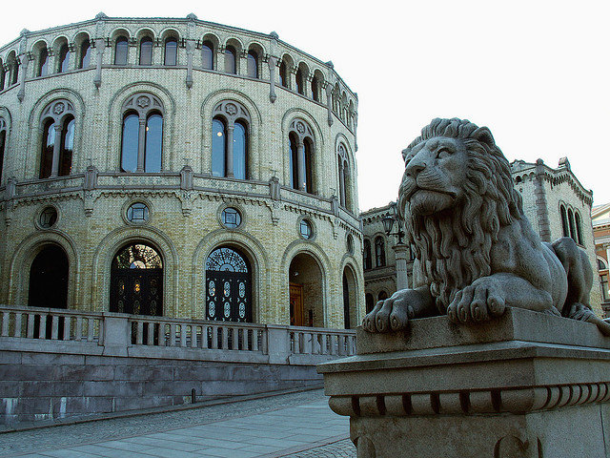
Recommendations for action

Slide 41
Recommendations for action
Further strengthening of the legislation:
Sanctions
Individual accommodation
Positive duties/prevention of discrimination
Compulsory equality training
Binding cooperation between the social partners
The offer of equality training must be expanded and adapted to the workplace
Access to information about rights

Slide 42
1 a) Sanctions
Violation of the equality- and anti-discrimination legislation, must have consequences
The Equality and Anti-discrimination Tribunal must have the competence to impose redress

Slide 43
1 b) Individual accommodation
There must be a clear obligation to provide individual accommodation to pregnant workers
A specific provision must be introduced/imposed

Slide 44
1 c) Positive duties
Legal prohibition is not sufficient to avoid discrimination
Employers must have a legal obligation to prevent discrimination in the workplace

Slide 45
1 d) Compulsory equality training
There must be a legal obligation regarding equality training for employers and company representatives
Training in how to promote equality and combat discrimination in the workplace
Today the training is optional

Slide 46
2. Binding cooperation in the tripartite cooperation
No changes in the labor market without involving the social partners

Slide 47
3. The offer of equality training must be expanded
In every region
Sector wise adaption

Slide 48
4. Access to information about rights
Pregnant women and fathers to be must be guaranteed information about their rights

