Slide 1
Planning for Equality in a Conservative Region
Lisbeth Reed, Vest-Agder County Council, KS 17.09.15
Notes:
1. Planning for Equality in a conservative region. Thank you for the invitation! I’ve been working in Vest-Agder County Council since 1999, most of the time on projects and plans concerning Equality , inclusion and diversity. We moved quite far onwards, and we like to share our experience.

Slide 2
EQUALITY: that all persons shall have equal rights and opportunities in society, regardless of gender, functional ability, sexual orientation, age, ethnicity and religion etc. The Norwegian word ‘likestilling’ has traditionally been used to refer to equality between women and men. This is still the most common use of the word, but, in recent years, its meaning has been expanded and now also includes other grounds for discrimination. Equality between the genders is often described as ‘kjønnslikestilling’ (gender equality).
Notes:
EQUALITY: that all persons shall have equal rights and opportunities in society, regardless of gender, functional ability, sexual orientation, age, ethnicity and religion etc. The Norwegian word ‘likestilling’ has traditionally been used to refer to equality between women and men. This is still the most common use of the word, but, in recent years, its meaning has been expanded and now also includes other grounds for discrimination. Equality between the genders is often described as ‘kjønnslikestilling’ (gender equality)
EQUALITY: that all persons shall have equal rights and opportunities in society, regardless of gender, functional ability, sexual orientation, age, ethnicity and religion etc. The Norwegian word ‘likestilling’ has traditionally been used to refer to equality between women and men. This is still the most common use of the word, but, in recent years, its meaning has been expanded and now also includes other grounds for discrimination. Equality between the genders is often described as ‘kjønnslikestilling’ (gender equality)
EQUALITY: that all persons shall have equal rights and opportunities in society, regardless of gender, functional ability, sexual orientation, age, ethnicity and religion etc. The Norwegian word ‘likestilling’ has traditionally been used to refer to equality between women and men. This is still the most common use of the word, but, in recent years, its meaning has been expanded and now also includes other grounds for discrimination. Equality between the genders is often described as ‘kjønnslikestilling’ (gender equality)

Slide 3
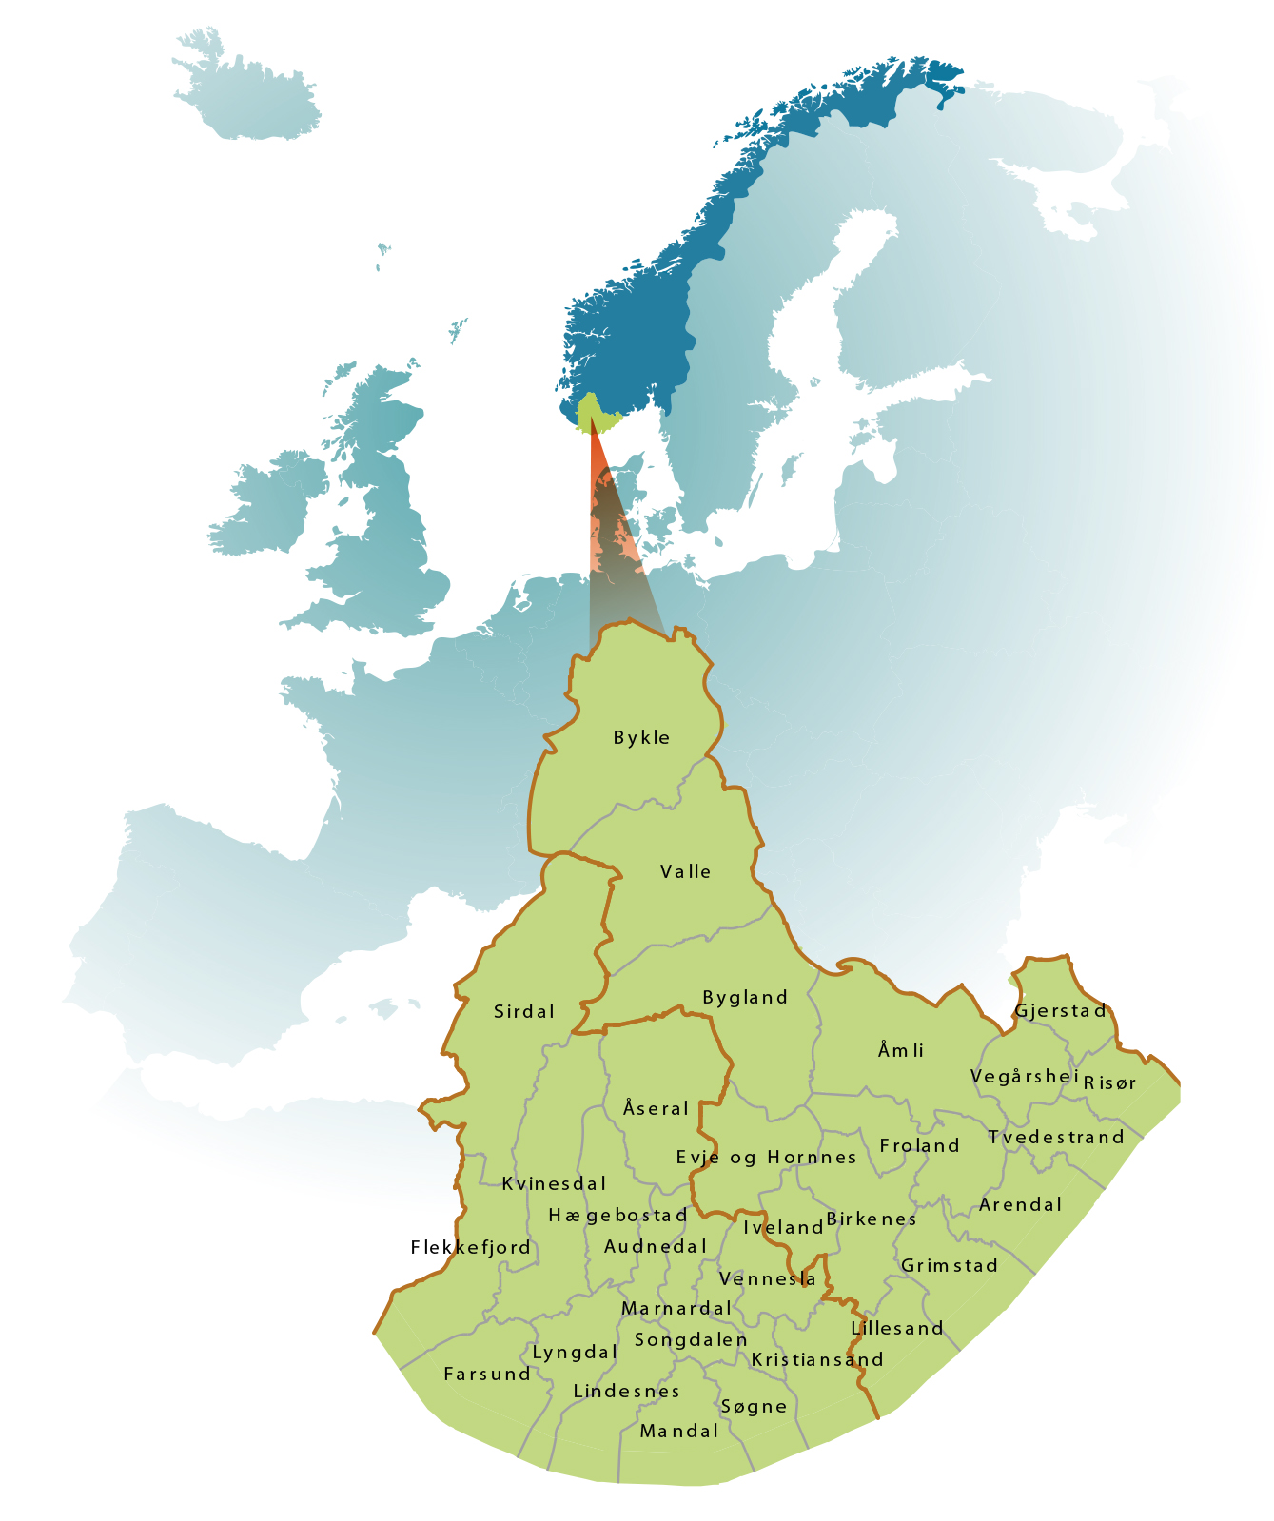
Agder:
Vest-Agder and Aust-Agder counties.
30 municipalities
292.000 inhabitants
Backgrounds from 140 countries
County capitals: Kristiansand (86.000 inh.) and Arendal (44.000 inh.)
Notes:
Agder is the southernmost region in Norway and consists of two counties and 30 municipalities. The counties, Vest-Agder and Aust-Agder, have a combined area of 16,500 km2, and a population of 283.000 inhabitants with backgrounds from 140 countries. The two largest cities in the region are the county capitals Kristiansand and Arendal with 82.000 and 44.000 inhabitants, respectively. The majority of the region’s population and businesses are concentrated along the coastline.
Agder is the leading region in Norway on entrepreneurship and export from processed goods. The industry in Agder is to a high degree based on energy intensive raw materials processing (e.g. aluminium, nickel, and silicium). The region is also host to world leading producers of off-shore equipment (drilling and mooring), and has also strong maritime industry clusters. Agder is one of Norway’s biggest producers of hydroelectric power.

Slide 4
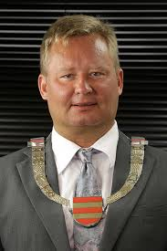
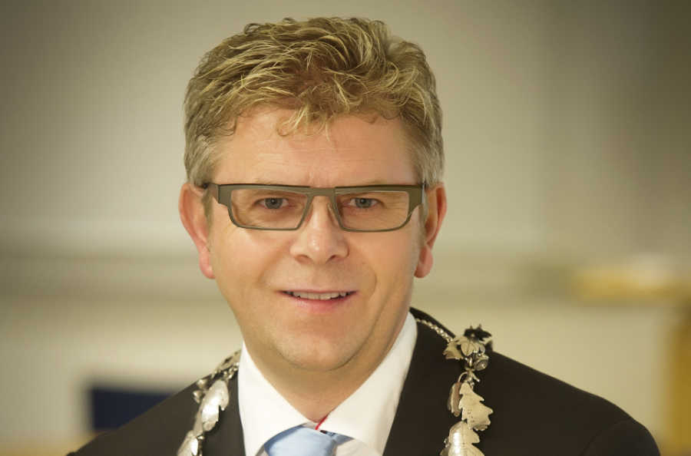
A conservative region
Cultural and religious areas
Politics
Notes:
Both in politics and cultural/religious areas. The last four years both County Majors have been elected from Høyre, the conservative party. And the Progress party that is neo-liberal right wing party also has much support and political positions. In several municipalities schools for the youngest children are closed on Wednesdays, and there is rather strong support for the view that mothers should stay at home with young children. The church is reluctant to gay marriage. Topic concerning LGBT-people were the most debated when making the regional plan for equality, inclusion and diversity last year. But the times are changing, just a little more slowly than elsewhere I Norway.

Slide 5
Challenges
Low equality scores (Statistics Norway)
Relatively poor living conditions
Research suggests there is a connection
Joint action to strengthen equality and improve living conditions
Notes:
Agder has scored poorly in Statistic Norway’s gender equality index since surveys began in 1999. The Agder counties also fare poorly in Statistic Norway’s survey of living conditions. The region stands out because of negative results on many of the indicators measured, and research indicates a connection between low levels of equality and poor living conditions in Agder.
There is also a strong positive connection between equality and what is good for the economy. For example, women’s increased participation in the labour market from the 1970s onwards has had a significant impact on value creation and prosperity. People are differently equipped to participate in society and the labour market. Implementing measures to ensure participation by everyone – investing in people – is expensive, but it costs even more not to. When groups are excluded, society loses out on their contributions to the community, and vicious circles, such as increase differences in health, often arise. Unless systematic efforts are made to prevent and reduce these differences, the cost to society will be high, both in terms of welfare benefits, health expenditures and loss of income.

Slide 6
Latecomer… and role model!
“The Agder region’s political approach to equality is virtually unparalleled at the regional level in Norway. Equality is discussed and emphasised as an important issue in regional planning processes, and development work is being done in several areas. The Agder region can therefore be described as both an equality latecomer
and an equality role model.” (Fafo report 2014)
Notes:
Planen er utarbeidet i løpet av 2014. 200 forskjellige mennesker har deltatt. Vi starta med en ungdomskonferanse 8.februar. Så har vi hatt fem åpne temakonferanser, brukerpanel og høringskonferanse. Det meste har vært lagt utenom vanlig arbeidstid for å slippe alle interesserte til. I brukerutvalget satt blant annet repr. for Skeiv ungdom og krisesenteret sammen med forstanderen i muslimsk union og biskopen i Agder. Vi har hatt innlegg av forskere, ungdommer, politikere, rådmenn og representanter for berørte organisasjoner. Og vi har brukt kreative metoder som har likestilt høyre og venstre hjernehalvdel i tråd med Albert Einsteins kloke ord: «Lek er den høyeste formen for vitenskap.

Slide 7
A long term commitment for Equality
1999: Statistics Norway starts publishing the gender equality index
2000-2007: Projects, measures and regional research
2008: The ten-year commitment for equality.
2008: Center for Gender Equality, University of Agder
2008-2012: Project Free choice
2012-2015: Equality as a regional force
2014: The Regional LIM-plan
2015: “It’s all about people” The LIM-strategy in Kristiansand
Notes:
Cross-party agreement that equality, inclusion and diversity should be a long-term and systematic priority in Agder. Both projects have developed tools and structures to improve equality through cooperation in the region.

Slide 8
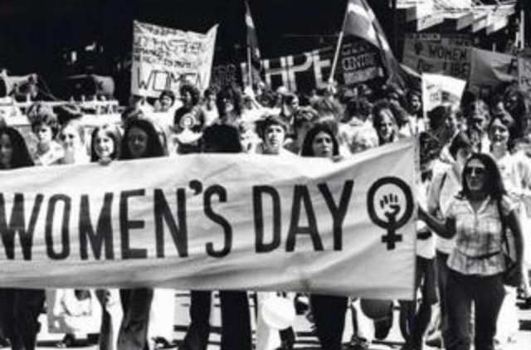
`Equality`: Women’s lib and radical movements?
Notes:
Planen er utarbeidet i løpet av 2014. 200 forskjellige mennesker har deltatt. Vi starta med en ungdomskonferanse 8.februar. Så har vi hatt fem åpne temakonferanser, brukerpanel og høringskonferanse. Det meste har vært lagt utenom vanlig arbeidstid for å slippe alle interesserte til. I brukerutvalget satt blant annet repr. for Skeiv ungdom og krisesenteret sammen med forstanderen i muslimsk union og biskopen i Agder. Vi har hatt innlegg av forskere, ungdommer, politikere, rådmenn og representanter for berørte organisasjoner. Og vi har brukt kreative metoder som har likestilt høyre og venstre hjernehalvdel i tråd med Albert Einsteins kloke ord: «Lek er den høyeste formen for vitenskap.

Slide 9
The first joint project: Free Choice 2008-2012
Eight different units from kindergarten to university.

Slide 10
Discovering equality
Kindergarten teachers were sure they treated boys and girls equally.
Their own performance videotaped showed otherwise.
This led to a strong motivation to change practice
Tools and manuals for Equality in kindergartens and schools were developed.

Slide 11
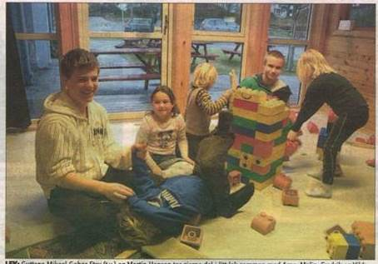
Men in kindergartens
Kindergarten practice for school-boys:

Slide 12
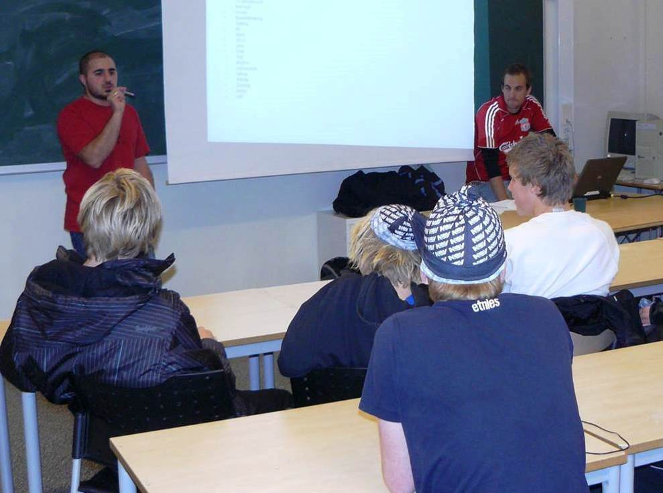
Recruiting the boys

Slide 13
The next joint project: Equality as a Regional Force 2012-2015
The ground had been prepared for a much wider scope.
A wide equality concept
Not only education, also business and industries and the public sector. Municipalities are crucial.

Slide 14
Equality in the strategic regional planning
Moving from projects to equality mainstreaming
Equality: A red thread in in the regional developmentplan from 2010 and the regional plan strategies in both counties
The LIM-plan – in accordance with the Plan and Building Act
Wide participation in developing the plan
Municipalities and regional state authorities have obligations to use the plan as base for their work.

Slide 15
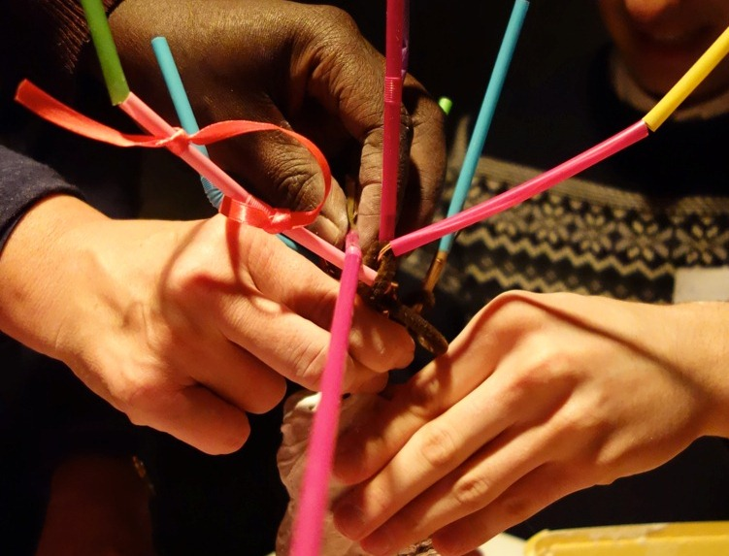
LIM start up: Youth Conference
Notes:
Planen er utarbeidet i løpet av 2014. 200 forskjellige mennesker har deltatt. Vi starta med en ungdomskonferanse 8.februar. Så har vi hatt fem åpne temakonferanser, brukerpanel og høringskonferanse. Det meste har vært lagt utenom vanlig arbeidstid for å slippe alle interesserte til. I brukerutvalget satt blant annet repr. for Skeiv ungdom og krisesenteret sammen med forstanderen i muslimsk union og biskopen i Agder. Vi har hatt innlegg av forskere, ungdommer, politikere, rådmenn og representanter for berørte organisasjoner. Og vi har brukt kreative metoder som har likestilt høyre og venstre hjernehalvdel i tråd med Albert Einsteins kloke ord: «Lek er den høyeste formen for vitenskap.

Slide 16
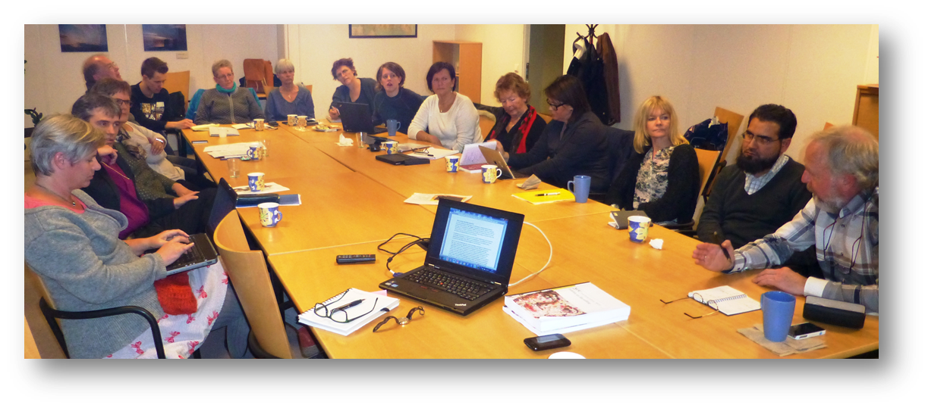
Wide participation in developing the plans.

Slide 17
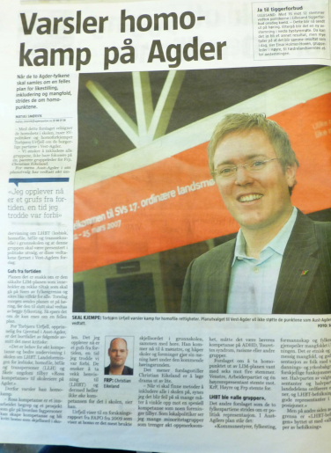
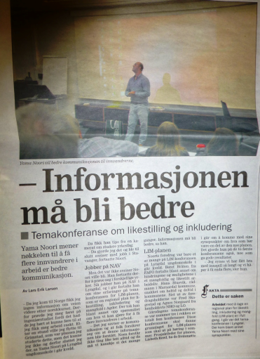
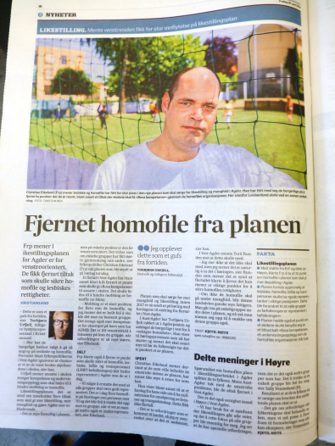
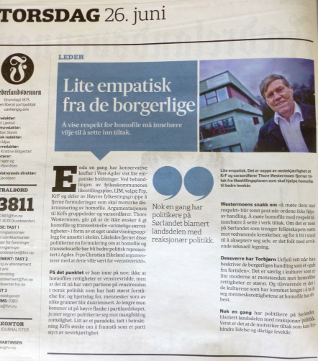
Heated Media Debate
Notes:
Som sagt var rundt 200 med i selv planprosessen. Høringen skapte også engasjement. Fire meningsforskjeller mellom fylkesutvalgene i Aust-Agder og Vest-Agder bidro til presse, oppmerksomhet og debatt.

Slide 18
Main Objectives 2027
1 Agder is a region characterised by equality, with good living conditions above national average.
2 Elected representatives and the public administration in Agder have extensive knowledge about equality.
3 Equality perspectives are a natural part of planning, strategy work, budgeting, research and analyses in the public, private and voluntary sectors.
4 Tools, models, results and research from the equality work are in active use and in demand throughout Norway.
5 Respect and cultural understanding permeate the local communities in the Agder region.

Slide 19
Five Topics
1.Democratic participation
2. Equality in education
3. Equality in labour market and workplaces
4. Equality of public service
5. Protection against harassment and violence.

Slide 20
Action programme
.Important measures:
Equality mainstreaming in counties and municipalities’ organizations.
A network for full time employment.
A network focusing on immigrants/refugees access to paid employment.
Developing a national equality and diversity standard for workplaces.

Slide 21
Anchored in the management. Leaders must be spokesmen
Efforts to promote equality and combat discrimination are part of our regular work.
The leaders have a responsibility to promote equality both with respect to the professional content of the activities and with respect to the relationship to users and employees.

Slide 22
The strategy in Kristiansand: It’s all about People
Vision:
Kristiansand municipality considers diversity as a resource, and is a future-oriented, competent and inclusive organization.
Kristiansand is a leading municipality when it comes to equality, inclusion and diversity
The strategy was adopted unanimously by the City Council

Slide 23
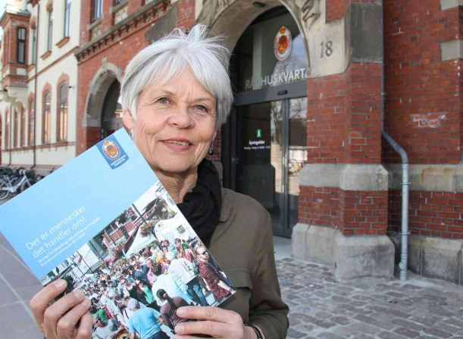
Success?
Success is dependent on prioritization
Both people and money is required
And showing that the plans work

Slide 24
The Human Resources
A FAIRNESS PERSPECTIVE
The right to life, freedom, safety, protection
against discrimination. Right til work, education, the best possible health and cultural/democratic participartion.
A RESOURCE PERSPECTIVE
We cannot afford not to act.
Participaton means added value.
THANK YOU FOR THE ATTENTION ☺

