Slide 1
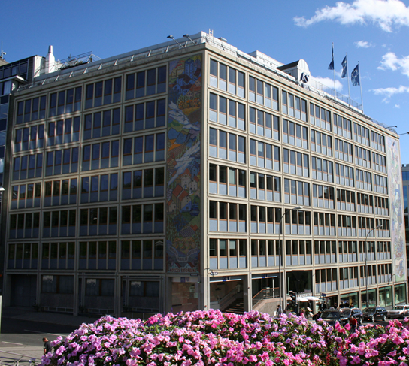
The Norwegian Association for Local and Regional Authorities –KS

Slide 2
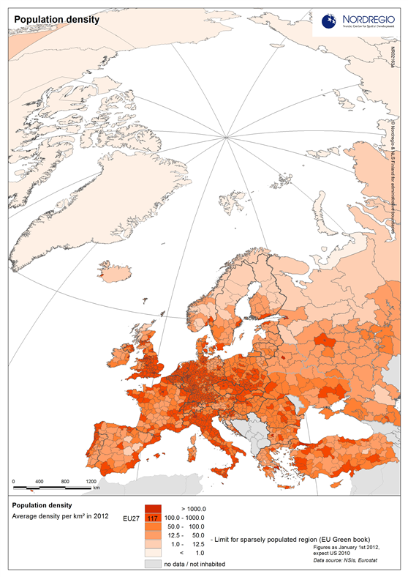
Norway
1800 km from north
to south
385 186 km2
5,1 mill inhabitants
16 people pr km2

Slide 3
Historical background
The association was founded in 1972
Amalgamation of
The Union of Norwegian Cities (founded in 1903)
Norwegian Association of Rural Municipalities (founded in 1923)
Employer association for local government since 1987
Notes:
In 1972 one joint national association for all regional and local authorities– as it is now - was founded. It was established as a result of the merging of the Union of Norwegian Cities and the Association of Rural Municipalities.
Norway was also the first country in Europe to approve an Act for the authority level under the central goverment – local authorities and regions. This was the Alderman Act of 1837 .
Since 1987 KS has also been an employer association for the locale governments.

Slide 4
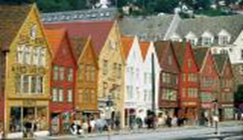
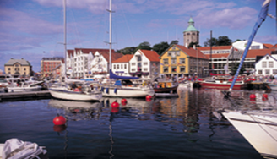
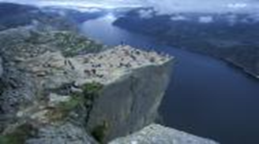
National members’ association for local government
428 municipalities
19 counties
500 public enterprises
Head Quarter in Oslo
8 regional offices
Office in Brussels
Notes:
KS is the only national association for Norwegian municipalities, with all the 428 municipalities, all 19 counties and approximately 500 public enterprises as our members. The 500 enterprises are companies/businesses or institutions, f. ex.: energy plants, water works, refuse collection and handling companies, recycling plants, kindergardens, etc. These companies are either owned by local/regional authorities or the main part of their operation/production is on contract with local/regional authorities – Public Private Partnerships or concessions.
Companies in local government sector may choose their employer affiliation, and many are members of NHO- the Confederation of Norwegian Enterprises. NHO and KS are to some extent competitors in the field of attracting these companies as members.
Many Norwegian municipalities are quite small. The largest one is Oslo with just above 600 000 inhabitants – the smallest is Utsira with 215 inhabitants.
Municipalities are encouraged to merge and/or cooperate to provide best possible services to the inhabitants.
KS har approximately 230 employees – about 170 of them in the Head Quarter in Oslo, and the rest in the 8 regional offices. KS is also organized in 17 County Executive Committees
KS has an office in Brussels with 3 employees.

Slide 5
KS roles
Interest and employer organisation
Spokesman vis-à-vis central government
Advisory and consultative body
Central collective bargaining organisation
Notes:
KS has different roles.
We are an interest and employer association.
The fact that we are an employer association for Norwegian municipalities is different from most of our sister associations in Europe.
KS advocates the interests of its members towards central government, the Parliament, labour organisations and other organisations.
KS advises and informs the members about all matters and developments of importance to local government.
KS facilitates exchange of experience between its members.
KS conducts the central collective bargaining on behalf of its members.

Slide 6
GOVERNMENT STRUCTURE
National government
Regional state level (administration)
Local/Regional government (elected)
Storting
169 rep’s
Government
17 ministries
Court of Justice
Regional
Governor
Government
agencies
Municipalities
428
County Authorities
19
Notes:
Fylkesmannen: regjeringens representant i fylket. Skal arbeide for at Stortingets og regjeringens vedtak, mål og retningslinjer følges opp i fylket. Utpekt av regjeringen
Regionale statsetater: sektororganiserte offentlige forvaltningsenheter, styrt av ulike sektordepartementer (samferdsel, innovasjon, velferd etc)
Fylkesmannsembetet utfører sine oppgaver innenfor fagområdene miljøvern, landbruk, beredskap og sosial og familiefeltet ved saksbehandling, rådgivning og veiledning, tilsyn, kontroll og rapportering.

Slide 7
ELECTIONS
Election period: 4 years
Local/regional elections
2007 2011 2015
2013 2017
National elections
Notes:
Local gov act:
Spesifies a minimun of repr to be elected. Less than 5000 inhabitants: 11 repr, 5000 – 11:000: miimum 19. Same in municipals and counties. Legal minimum, up to elected body to dermine larger councils.
Elects a executive body. Minimum 5 personer, proposes 4-year fiscal, economi plan, budget and taxes.

Slide 8
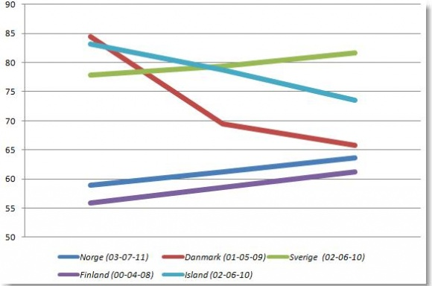
Voter turnout

